Slide 1

Options Project Presentation
Team Olympio

Slide 2
Team overview
Teams
Carl Wei
Bsc Statistics
Nishita
Parikh
Msc Financial Stats
Alistair Law
Bsc Geography & Economics
Ulrik Aakre
Msc Info Systems Management
Daniel Seymour
Bsc Philosophy & Economics
Experience
Algorithms
Finance
Time Series
Data Science
Programming
Data analysis
Programming
Data analysis
Programming
Tasks
Algo design
Question forum maintenance
Data Storage
Data Exploration
Independent strategy
Multi-Processing
Helper Functions
Data Storage
Helper Functions
Algo Design
Helper Functions
Process
Weekly Meetings
Google Sheet-based Anonymous Question Forum

Slide 3
Overall Strategy Thesis Optimizing performance given risk constraints
Risk Management
Optimized Performance
Execution Risk
Market Risk
Inventory Management
Order price management
Order size management
Execution Risk
Time limit
Position limit
Maintain Delta Neutral
Dynamic sizing & pricing to OPTIMIZE for trading profits GIVEN risk constraints

Slide 4
Trading algorithm
Calculate ideal prices
Retrieve Hedge_Instrument orderbook
Calculate fair prices for all derivatives
Dynamic Pricing based on:
Existing Position
Hedge_Inst Position
Volatility Skew
For inst in inst_with_derivatives:
For inst_id in all_derivatives_of_inst:
Calculate ideal prices
Active_List = sort inst_ids for active
Trade all inst_ids in active_list
Passive_list = sort inst_ids for passive
Send limit orders for insts in passive_list
Hedge overall
Active
Clear orders (if opp identified and might lead to self trade due to other side limit)
Sort
Trade
Sorting based on:
Margin opportunity
Position opportunity
Position opp based on:
Existing inventory
Existing hedge_inst inventory
Outstanding Limit orders of other derivs with same delta
Passive
Clear if ideal price changed, otherwise stay to ensure priority in queue
Sort
Trade
Hedge
Hedge Overall
Calculate overall delta & hedge through IOC

Slide 5
Innovation I - Optimizing performance under execution risk
Time_set
Keeping a set of time{t1,t2…,t25}, representing time when I submitted a request to the exchange (amend/cancel/ioc/limit etc..);
Whenever I want to execute sth, I check if current time is >= t1+1s. If not, I try again until I can execute. If success, I update the time_set by removing t1 and add my current time.
Ensures most efficient execution without waiting for a fixed amount of time
## Whenever I want to execute something:
While True:
cannot_trade, time_set = check_time_breach(exchange, time_set) ----checking
if cannot_trade:
continue
execute (e.g. exchange.delete_orders….)
___, time_set = check_time_breach(exchange,time_set) ---updating

Slide 6
Motivating Innovation II Constraint: Delta always Hedgeable
Given this, we want:
At any time, our worst case delta of all derivatives has to >=-100 & <=100
Worst case delta = combined delta of all outstanding derivative orders that might lead to positive/negative delta gets added together
i.e. what’s my net delta if all my limit orders of (bid call, bid futures, ask puts) gets taken immediately, plus the delta of existing derivatives on my book?
We won’t allow it to be >100 since we cannot buy/sell more underlying to hedge it
Abs(new_delta) from each loop of active trade has to < 30 (we don’t want each iteration to generate too much new delta because
that may make hedging expensive and
we want to implement dynamic pricing which requires more gradual position increase

Slide 7
Motivating Innovation II Idea: delta-based trading (instead of instrument-based trading)
optimal execution given delta constraint
Example
I have bought a lot of futures in my active strategy. I therefore prefer to have more negative delta, otherwise my delta will not be hedgeable.
In my passive strategy, I therefore prefer to send orders of trades that will lead to negative delta first (e.g. buying puts, selling calls), before trades that will lead to positive delta (selling puts, buying calls, buying futures).
In comparison to a normal buy/sell based trading – puts have negative delta so if I send order which sells a lot of puts, that may lead to my position not hedgeable
1 unit of delta
x units of instrument
Given our fixed constraints in additional delta, how can we best use these delta allocations?

Slide 8
Innovation II Optimal Basket Execution
For both active & passive strategies, efficient execution is incorporated into 4 aspects:
Existing Position (Retreat)
Hedge_Inst Position (even though delta is hedged, we prefer to clear space for inventory to allow for more trading)
Volatility Skew (during testing we saw we are systematically biased to short puts, so we increased our credit)
Given our fixed constraints in additional delta, how can we best use these delta allocations?
Pricing
Existing Position
Hedge_Inst Position
Volatility Skew
Pos_delta_basket = [[inst_1,price,vol,inventory_bound, hedge_bound,side],[…],…]
Neg_delta_basket = [[inst_1,price,vol,inventory_bound, hedge_bound,side],[…],…]
Intra basket sorting
Price opportunity
= ±(available market price - ideal price) depending on bid/ask
Size opportunity
bound by 1.hard delta limit per trade, 2.existing inventory, 3.worst case delta/hedgeability)
Inter basket sorting
Net delta
If net delta > 5, we prefer to first generate negative delta
Hedge_inst Position
If delta is flat, then if underlying stock inventory >0, we would prefer to generate positive delta first
Dynamic sizing
Execute the instruments in the 2 lists.
If passive strategy, then during execution of each list, we monitor if our size opportunity is bounded by worst case delta. If so, we reduce our limit order volume after the previous one has been executed. If not, then size not affected by previous execution, and we don’t worry.
If active strategy, then execute one first, another one, and then the first one again. this ensures any freed up delta capacity can be used.

Slide 9
Risk management at all levels of the strategy
Calculate ideal prices
Retrieve Hedge_Instrument orderbook
Calculate fair prices for all derivatives
Dynamic Pricing based on:
Existing Position
Hedge_Inst Position
Volatility Skew
Execution Risk
Market Risk
Active
Clear orders (if opp identified and might lead to self trade due to other side limit)
Sort
Trade
Sorting based on:
Margin opportunity
Position opportunity
For inst in inst_with_derivatives:
For inst_id in all_derivatives_of_inst:
Calculate ideal prices
Active_List = sort inst_ids for active
Trade all inst_ids in active_list
Passive_list = sort inst_ids for passive
Send limit orders for insts in passive_list
Hedge overall
Position opp based on:
Existing inventory
Existing hedge_inst inventory
Outstanding Limit orders of other derivs with same delta
Passive
Clear if ideal price changed, otherwise stay to ensure priority in queue
Sort
Trade
Hedge
Hedge Overall
Calculate overall delta & hedge through IOC

Slide 10
Other initiatives & explorations
Helper Functions
Calculate overall delta of position
Clear all outstanding positions
Quick market order without specifying price
Calculate delta of all outstanding limit orders that will generate (positive/negative) delta
Show outstanding volumes
Position recorder
……
Data Storage
Function that runs for X minute with Y observation frequency, returns a DataFrame containing price/volume info for all specified instruments
Function that runs continuously while running our trading algo, updates the df in real time to allow for calculation of rolling means/z-scores
CSCO Mean-reversion Strategy
Identified CSCO as the only sequence with stable stationary behavior over different windows.
Attempted to build a separate strategy using rolling z-score as signal; abandoned due to limited time
Exploratory Data Analysis
How’s the (3m/5min/10min)correlation between different instruments using 0.1s/0.2s/0.5s as observation frequency?
Do any stocks exhibit mean-reversion behavior in 3min/5min/10min using 0.1s/0.2s/0.5s freq?
How’s the liquidity profile across instruments?
Can we predict price changes using relative thickness of bid/asks on LOB?
….
Multi-Processing
Using MultiProcessing Package to run multiple strategies in parallel (NVDA,SAN,CSCO)
Failed as exchange could not be shared as a multi-manager object in the package

Slide 11
Learnings & Discussions
Programming
Scalable Framework
Many functions & logic were specific for dual_listing but not scalable for other instruments, which led to unnecessary time spent rewriting the strategy
Principle of Modularity
Helper functions, components of different strategies could be more separated
What could we do better?
Strategy
Manageable Risk ≠0 Risk
Biggest constraint in our strategy; in the final competition we saw most teams having much higher delta limits; perhaps a more passive delta targeting strategy should be employed and we shouldn’t adhere to the strict 0 delta bound, which will free up abundant capital
Process
Balancing improvement vs Investment
Speed might be an issue but we don’t need to optimize for every aspect (e.g.we shouldn’t spend 2hrs working on sth that increases speed by 10μs)
Debugging
Should be sketching out general strategy, and then making improvements gradually; that way it’s easier to understand what caused any poor performance
Time buffer
Leave more time for live testing pnl, optimizing parameters & stress testing function performance

Slide 12
Thank you!

Slide 13
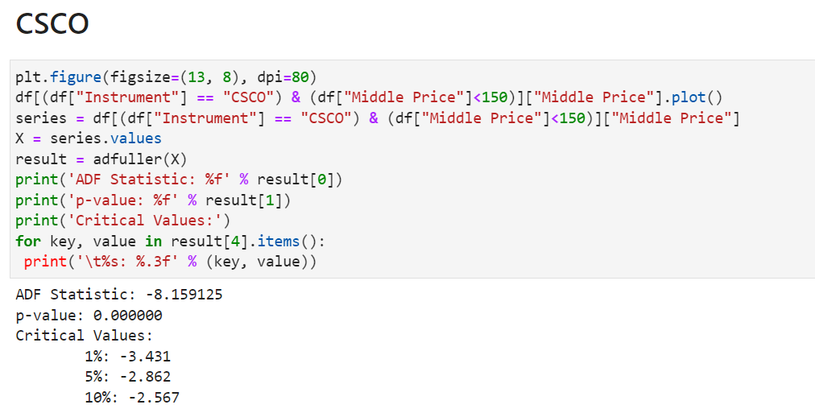
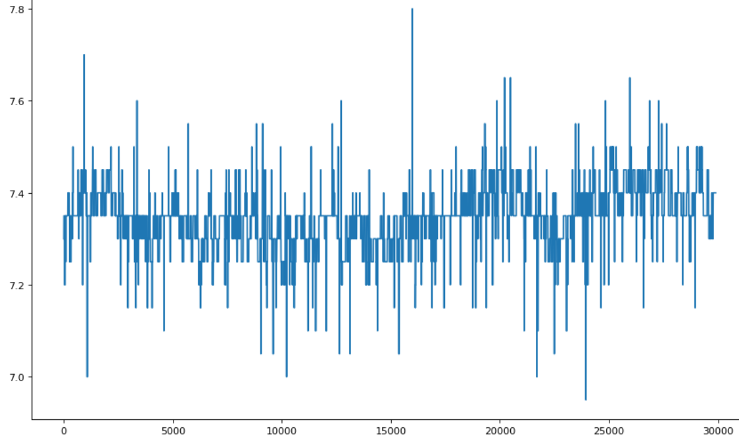
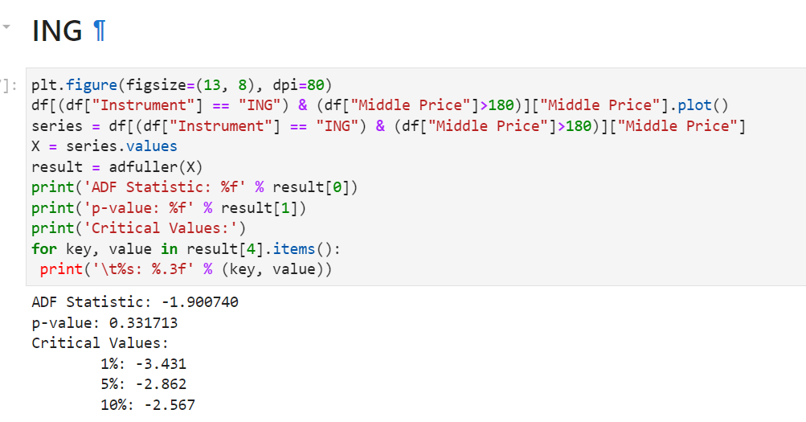
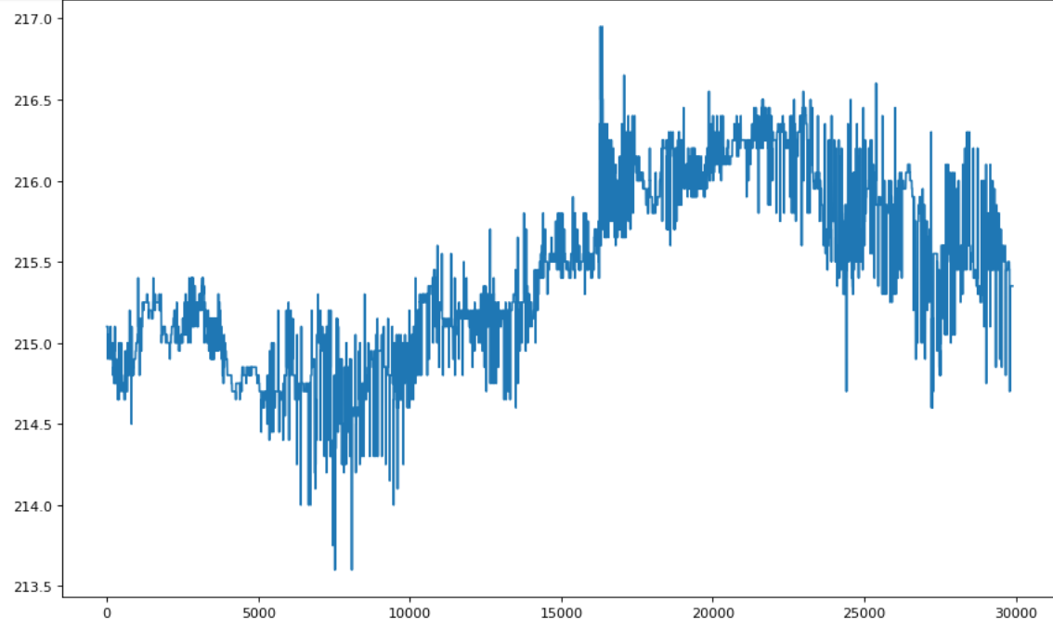
Appendix A
CSCO shows stable mean-reversion behavior

Slide 14
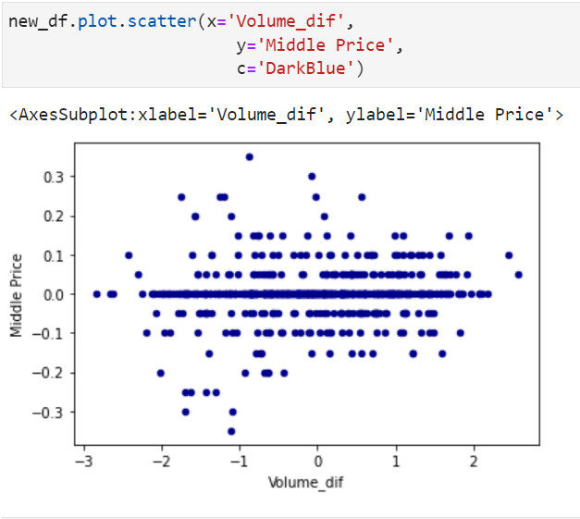
Appendix B
Relative Orderbook Thickness has limited predictive power for price (and returns too)

Slide 15
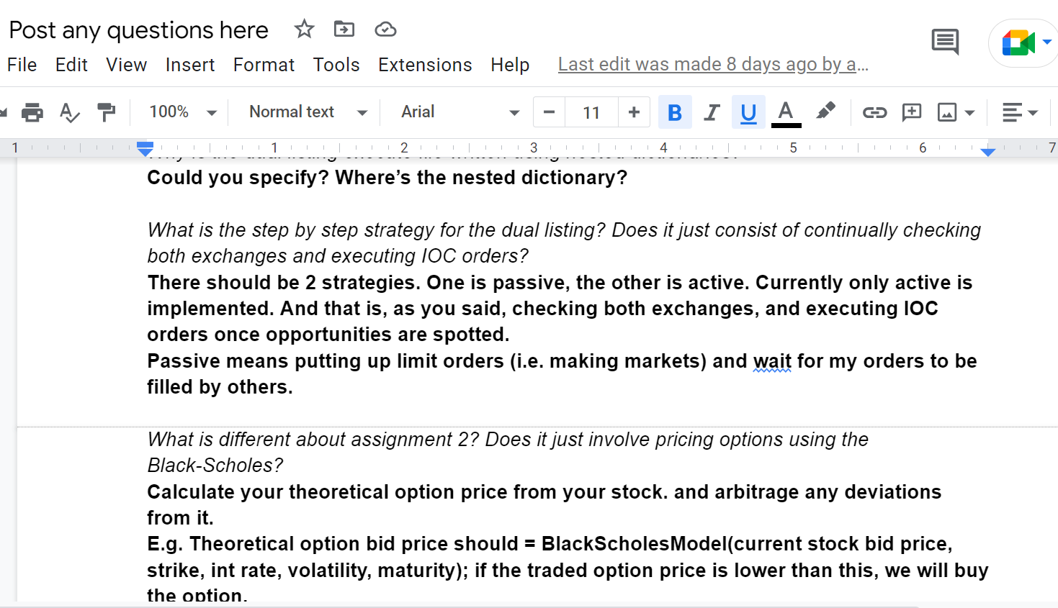
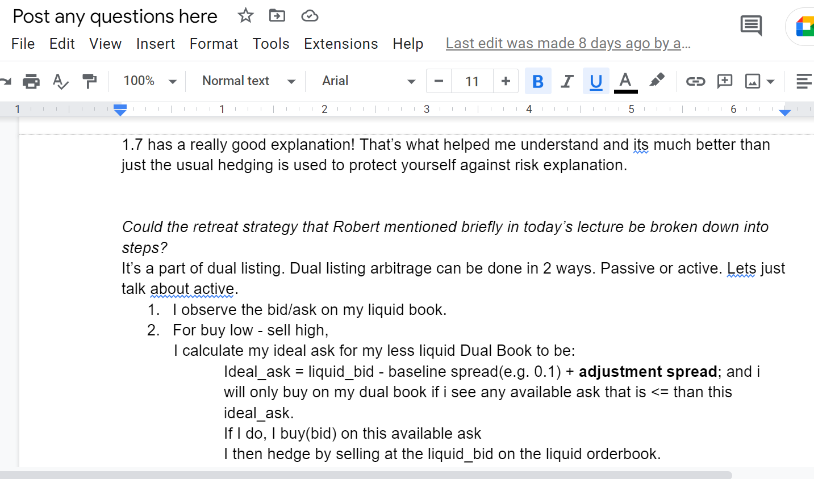
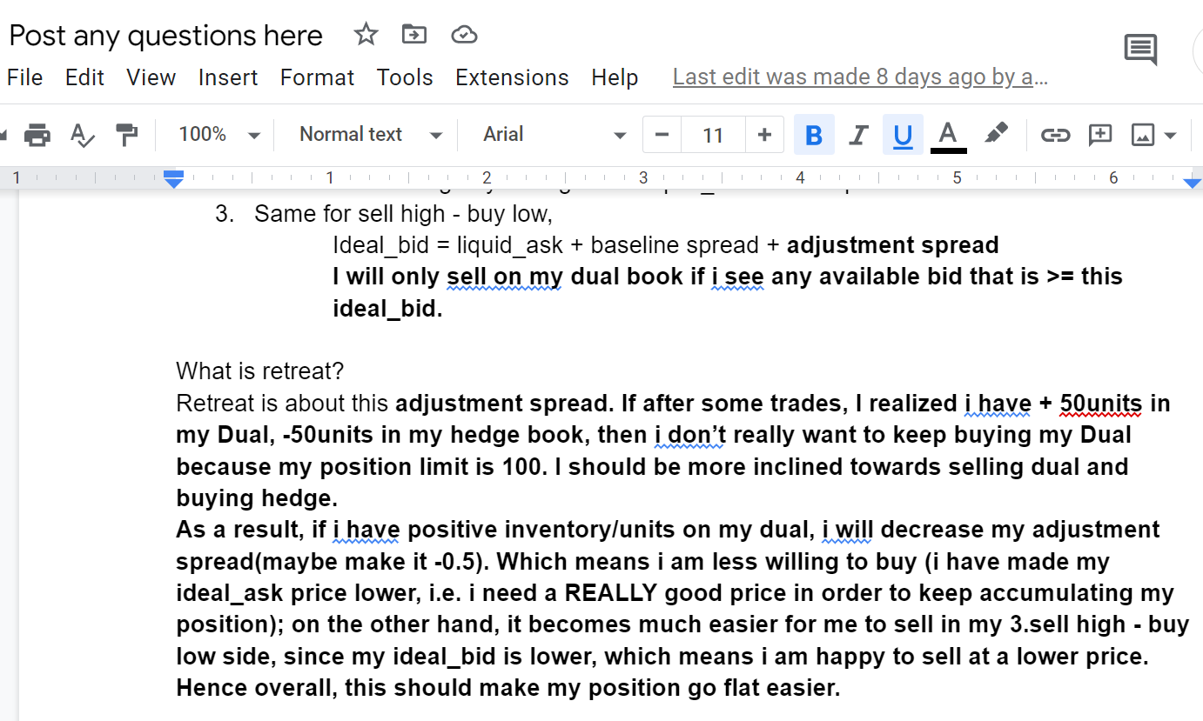
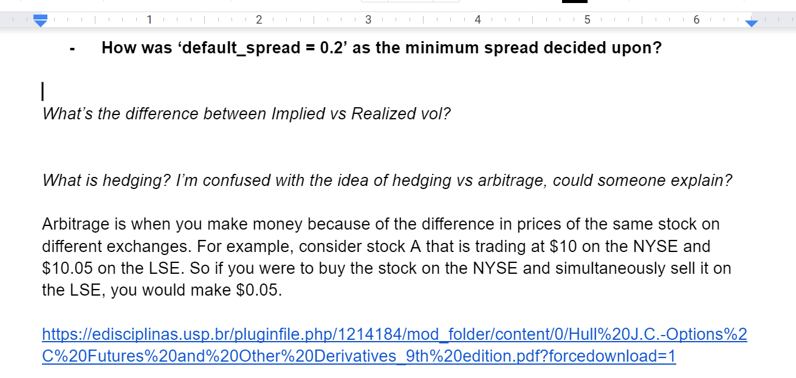
Appendix C – Team Question Forum

Slide 16
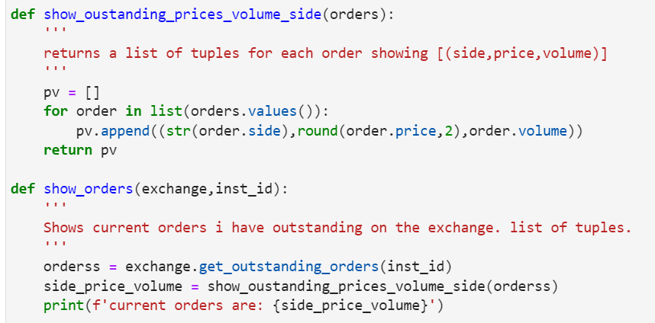
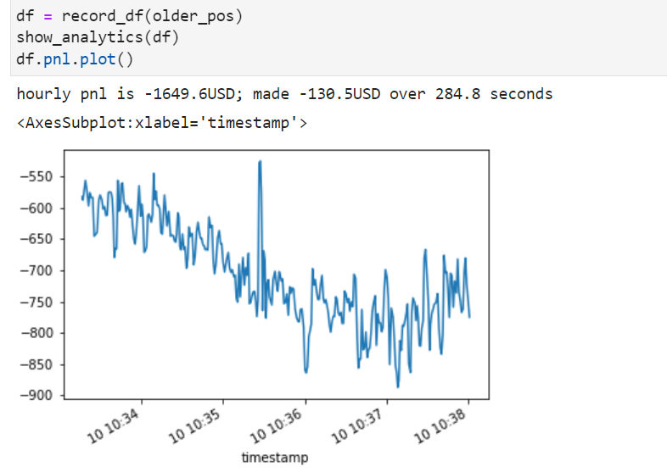
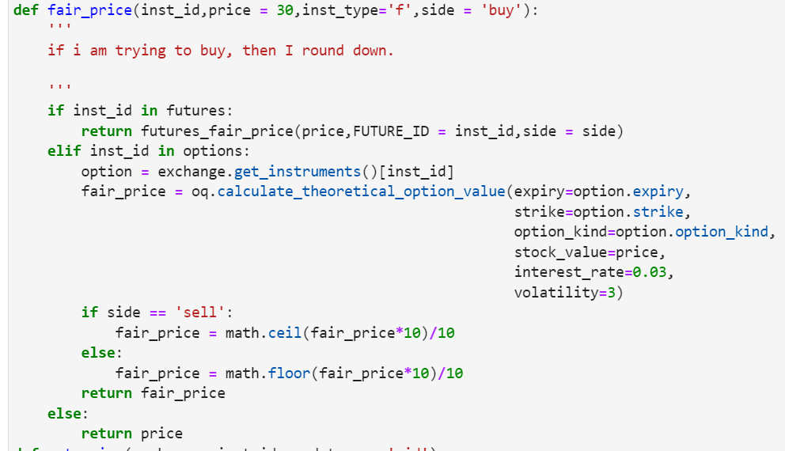
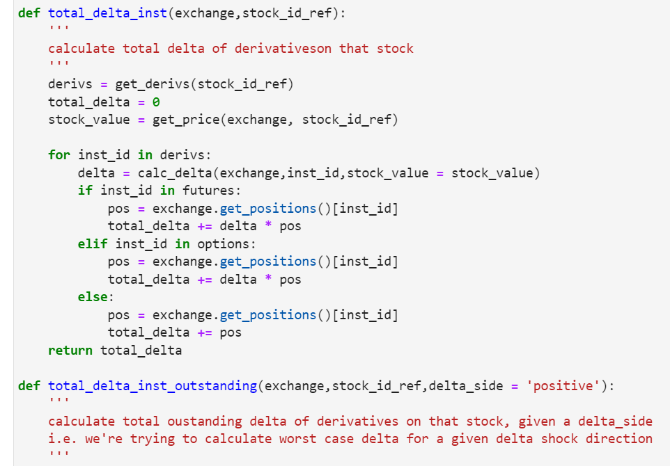
Appendix D – Example Functions

Slide 17
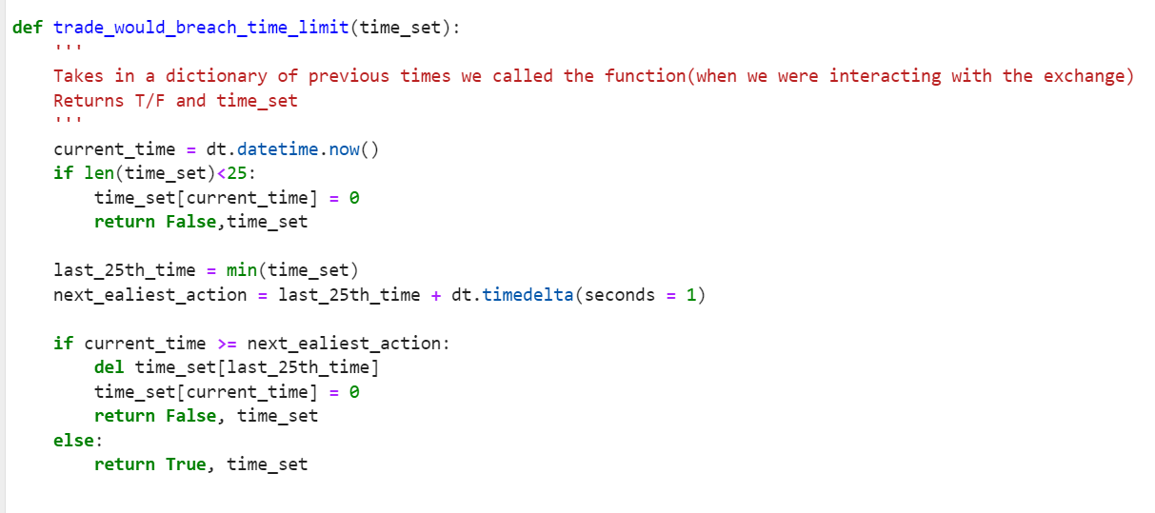
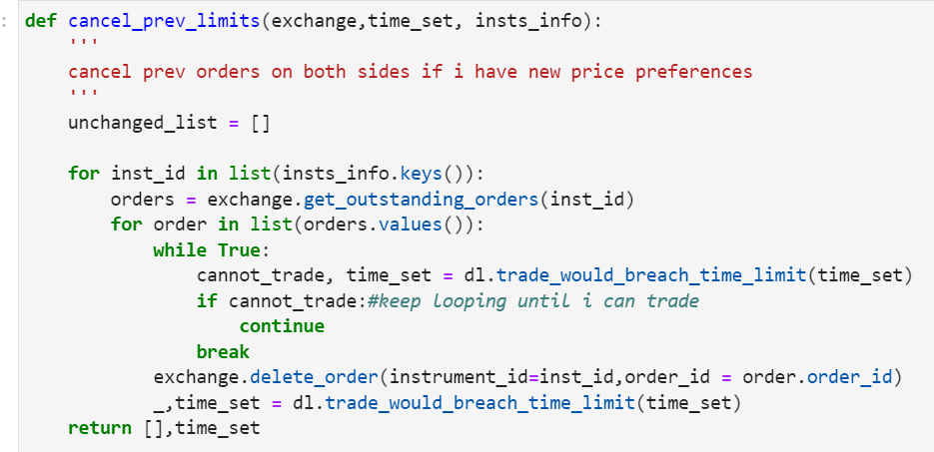
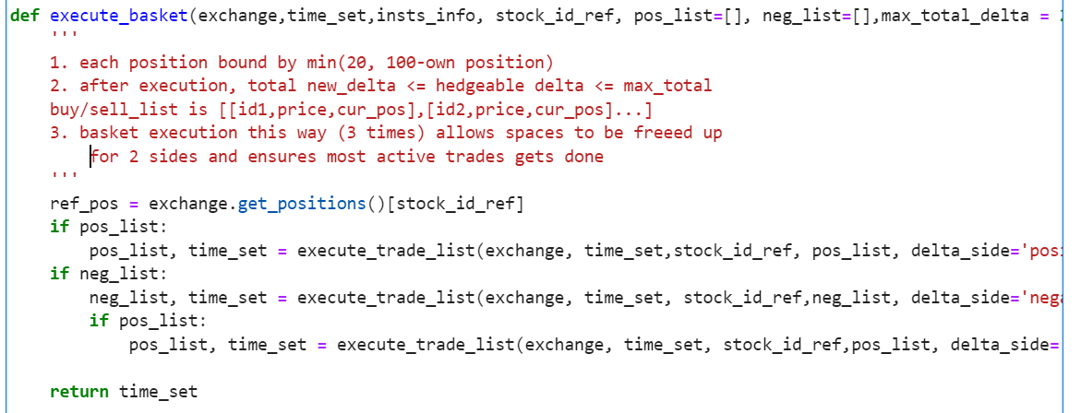
Appendix D - Example Functions

